Slide 1
Inventory management system
Kaustubh Khairnar (12858)
Saurabh Deo (12856)
Darshana Rathi (12858)
Ishita Koske (12857)

Slide 2
AGENDA
To create a web application for inventory management system of food manufacturing unit.
To reduce the manual work of stock entry and stock checking and giving it a computed approach.
To create a interface between customers and user of food manufacturing unit (Aaheli)

Slide 3

INTRODUCTION
This system is for Aaheli food manufacturing unit. Aaheli is located at Aurangabad, Maharashtra. Aaheli manufactures food products for companies / customers who has their recipes but need a manufacturer to process it in large quantity. It’s a B2B company.
This system is an inventory management system which would help the client to manage its stock, recipes and orders. It’s a system which would reduce the manual work of updating the stock and checking it.
In this system user can add new recipes, update stock details, maintain supplier details, update status of current order, store and get recipes for multiple recipes. This system will also provide a service to the customers of Aaheli. Where they can place order, check status of their order, navigate through their previous order.
2021-22
Inventory Management System

Slide 4
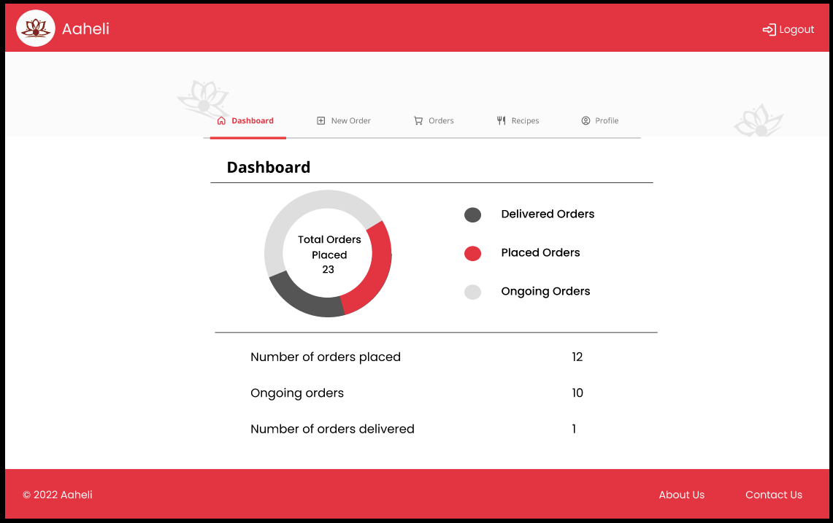
Appearance
A simple, easy to understand and use interface has been created for the user. Anyone with basic computer knowledge could access this system, and get benefited from it.

Slide 5
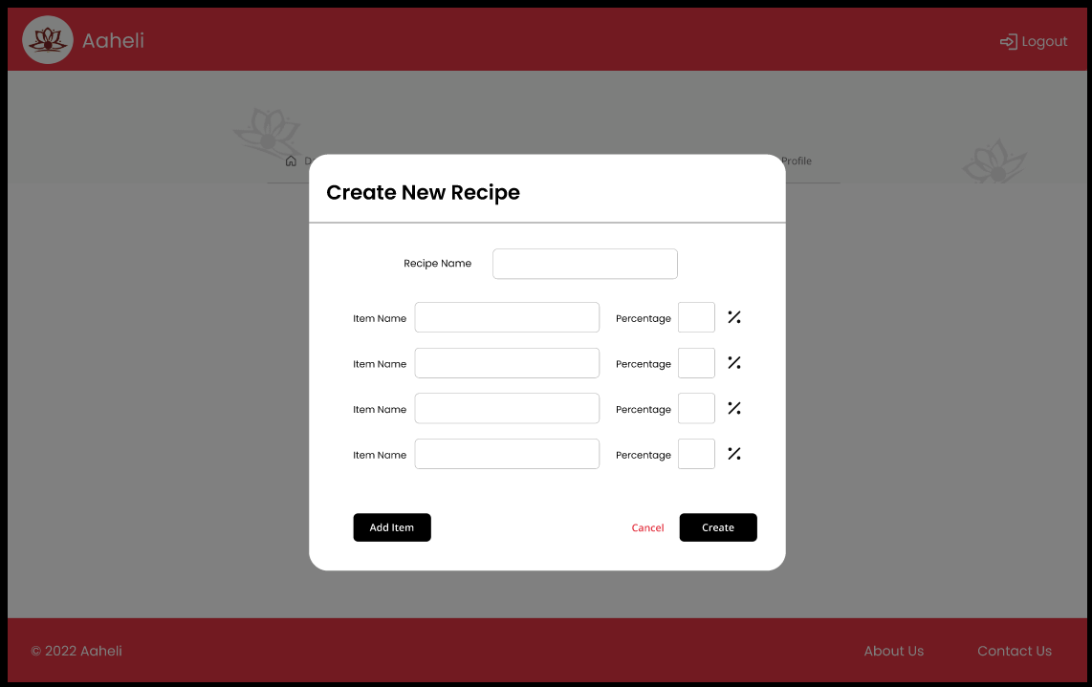
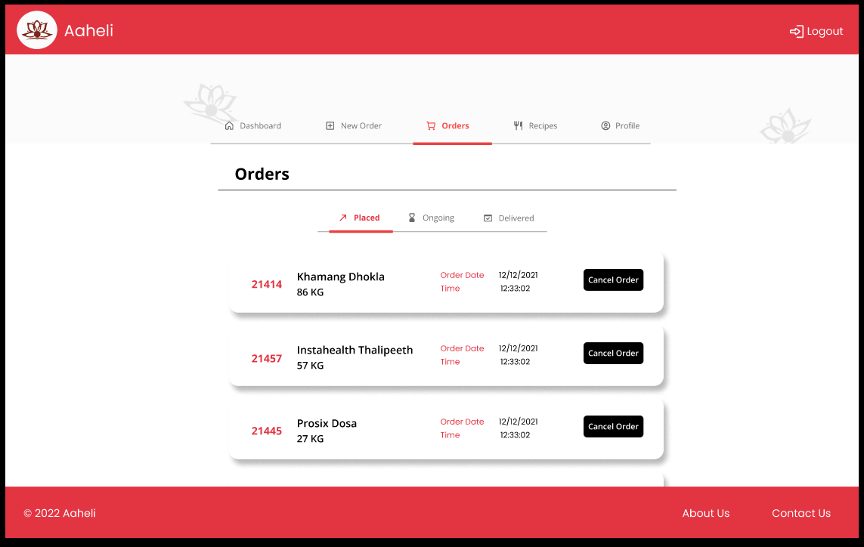
Inventory Management System

Slide 6
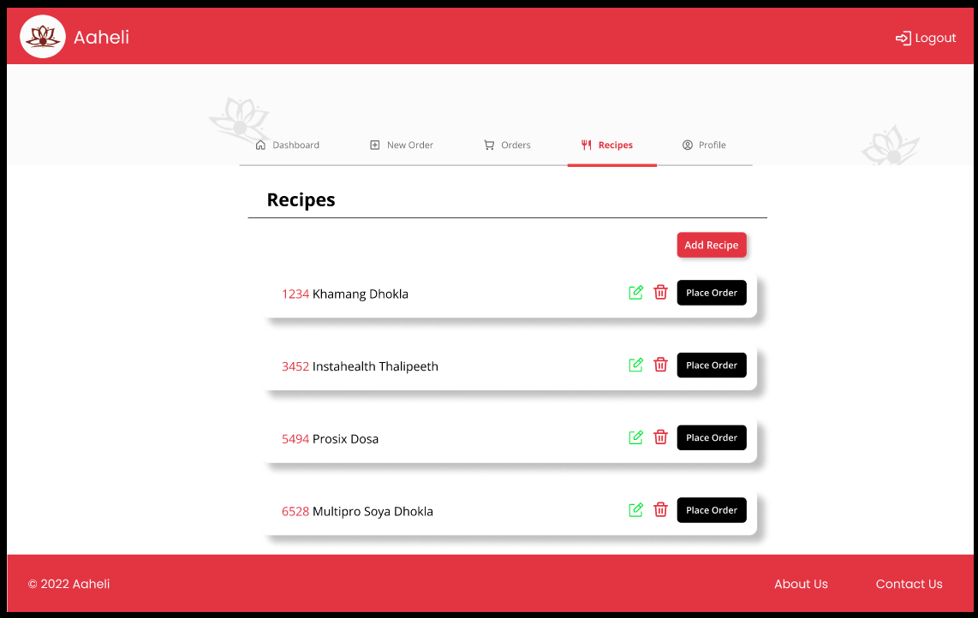
What does the system do ?
So basically this system gives the user and interface to store the recipes in percentages and give the output as perfect quantities for the given batch as input.
It also provides an interface to the customers of Aaheli where they can place order, add recipes, check the status of the given order.
2021-22
Inventory Management System

Slide 7
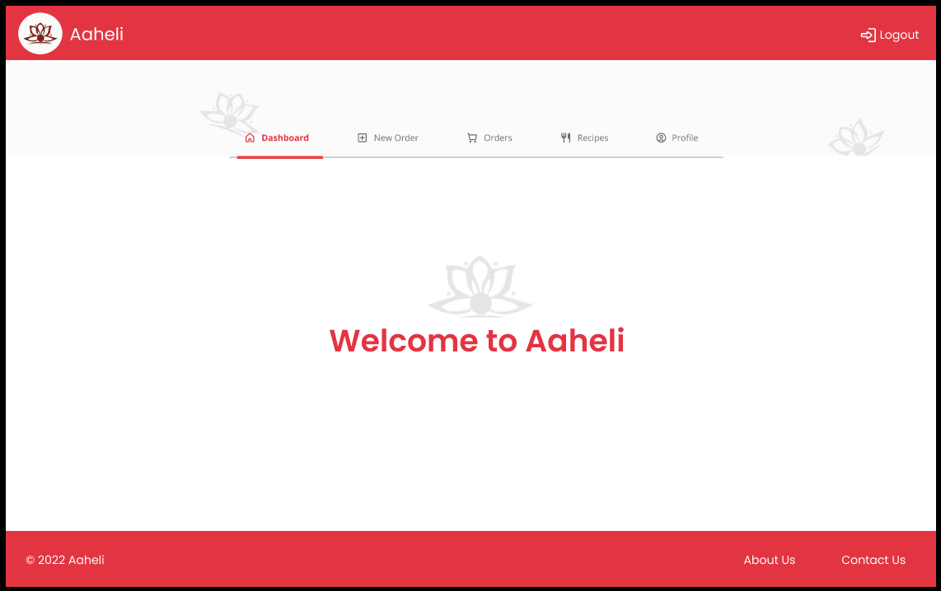
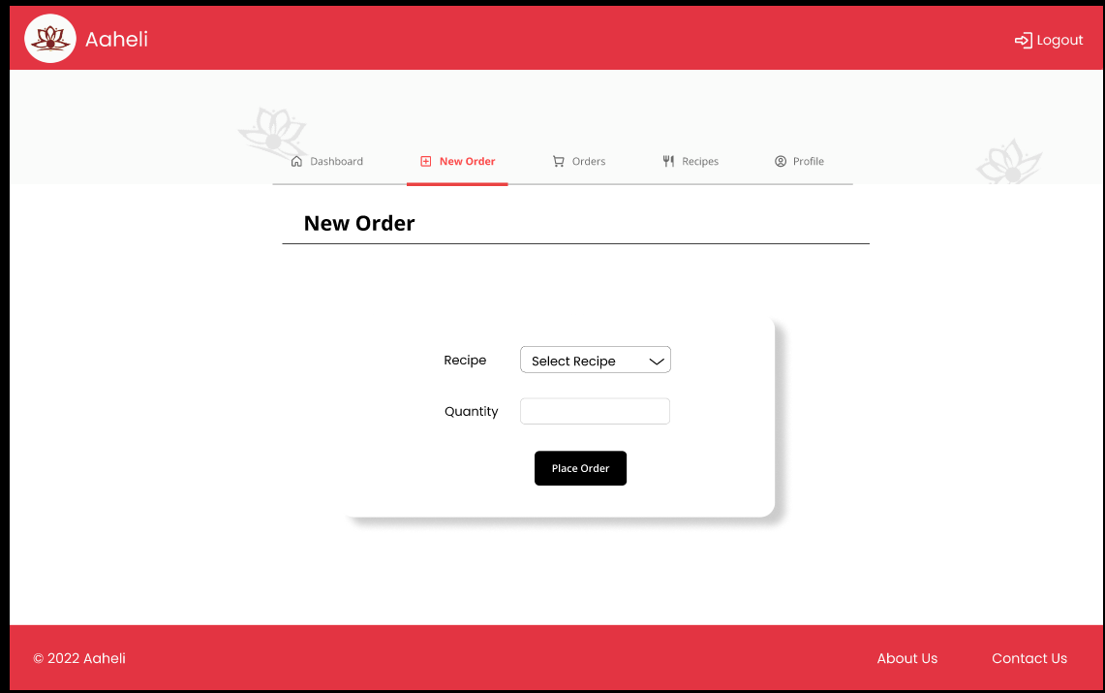
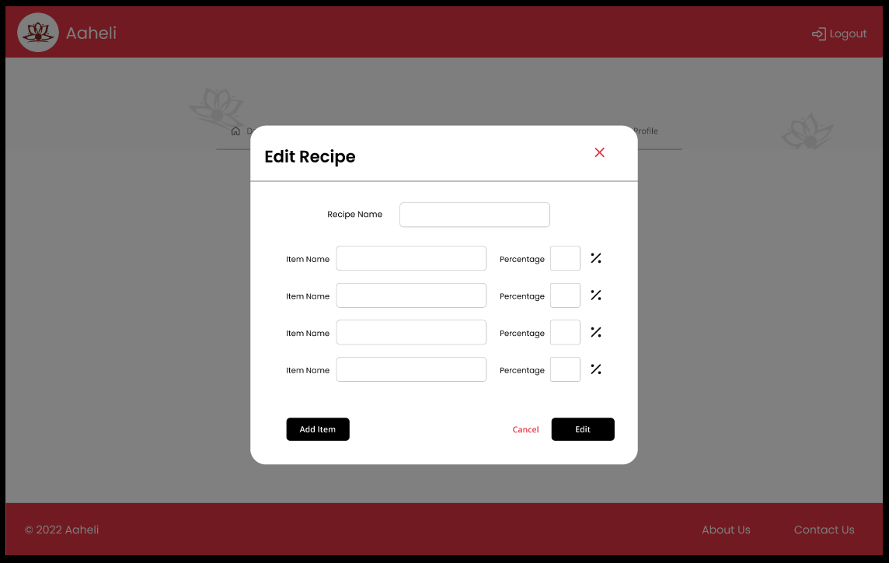
2021-22
Inventory Management System

Slide 8
AREAS OF FOCUS
To reduce the theoretical calculative work
Benefit for customers of Aaheli
In this system recipes could be stored without any hazel and actual quantity or raw material would be given as a output to the user.
Checking the stock of raw material manually would also become easy as you can see it on the system .
Customers of Aaheli could place there orders and check its status on the website.
Customer could also add his recipe which he/she wants Aaheli to manufacture.

Slide 9





Technical Flow of System

Slide 10




Software's used to Create the system
Visual Studio code
Xampp
Google Chrome
Postman

Slide 11
System Requirements
Computer or Processor | Intel® Core™ i3 and above
Memory (RAM) | Minimum of 4 GB.
Hard disk | 20gb of free hard disk space
Optical Drive | Internal or External x8 drive
Display | XGA (1024 X 768 pixels) or higher resolution monitor with 16 bit color setting
Input Device | Keyboard and mouse or compatible pointing device
Internet Connection | Network using 10MBPS or higher speed network adapter and/or WLAN.
Miscellaneous | USB Interface Required. A Battery pack that may provide 500 mA via USB.
2021-22
Inventory Management System

Slide 12
SUMMARY
So to summarize, this system is made to enhance the work and computerize the work for food manufacturing industry of maintaining stock statements and recipes on a pen and paper. Giving their customers a interface to book order and check the status and stay updated. Also to have a hazel free experience while dealing with Aaheli.

Slide 13
THANK YOU
Project by:-
Kaustubh Vijay Khairnar
Darshana Deepak Rathi
Ishita Vishal Koske
Saurabh Santosh Deo
Guided by:-
Mrs. Chitra Nagarkar

